Slide 1
React js
rishi

Slide 2
React Introduction:
A JavaScript library for building user interfaces
Focus on UI
Rich Ecosystem
Developed by Facebook
Huge Community. Very Popular. Needed Skill in market
React can also render on the server using Node and power mobile apps using React Native.
https://reactjs.org/

Slide 3
Component-Based
Build encapsulated components that manage their own state, then compose them to make complex UIs.
Components are reusable
Since component logic is written in JavaScript instead of templates, you can easily pass rich data through your app and keep state out of the DOM.

Slide 4
Declarative
React makes it painless to create interactive UIs.
Tell React what to do – let react decide how to do it.
Declarative views make your code more predictable and easier to debug.

Slide 5
Pre-requisite
HTML (Must - https://www.youtube.com/watch?v=ATmKiI6xuJI)
CSS (Must)
JavaScript (Must – We are covering it today)
ES6 (We will learn it along)

Slide 6
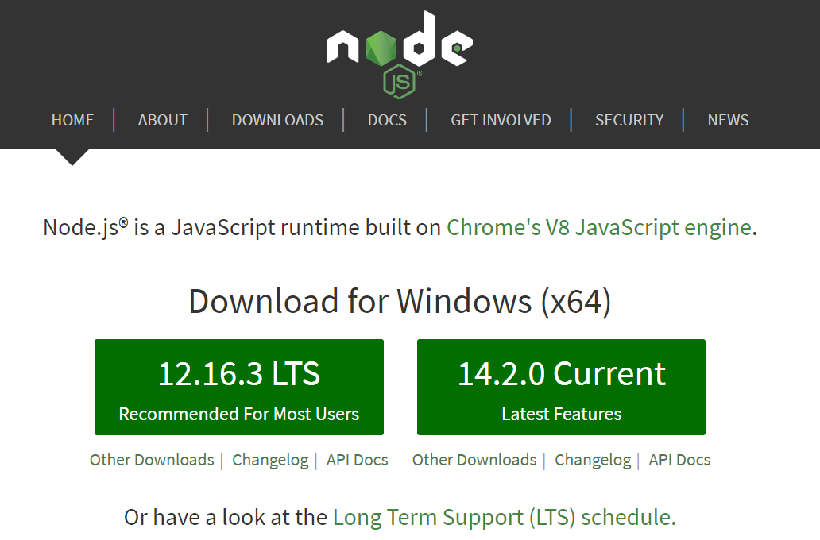
Lets Start: Step 1
Install Node:
https://nodejs.org/en/

Slide 7
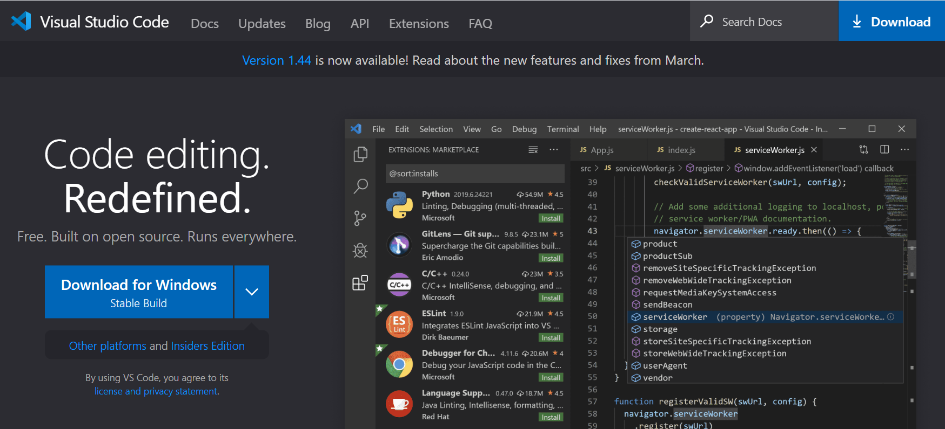
Lets Start: Step 2
Install Visual Studio Code
https://code.visualstudio.com/

Slide 8
Hello React Code:
Start Visual Studio Code:
Create a new Folder for React (For me its : Rishi/H2K/React)
Open Terminal from VSC
Give this command: npx create-react-app hello-world – and wait for it to respond
https://github.com/facebook/create-react-app

Slide 9
Hello React:
npx create-react-app hello-world
cd hello-world
npm start
Browser will open at localhost:3000

Slide 10
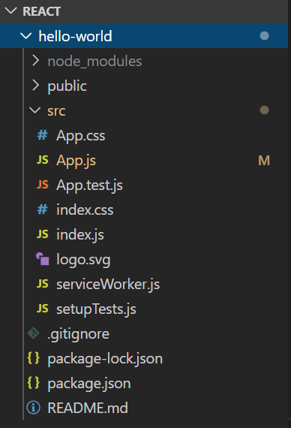
Project dependencies are installed here
Open this Folder, it has image and index.html
App component: view in browser
Calls Root from index.html
Dependencies link and consistancy
Project dependencies

Slide 11
Component
Header
Root Component
Side
Navigator
Main Component
Footer Component

Slide 12
Component
Stateless Function Components:
JavaScript Functions
Stateful Class Components
ES6 Classes extends React.Component
Has to implement render() method
Render() returns desired ouput (HTML_
Header
Root Component
Side
Navigator
Main Component
Complex UI = Large number of Components.
Facebook has 35000+ components
Footer Component

Slide 13
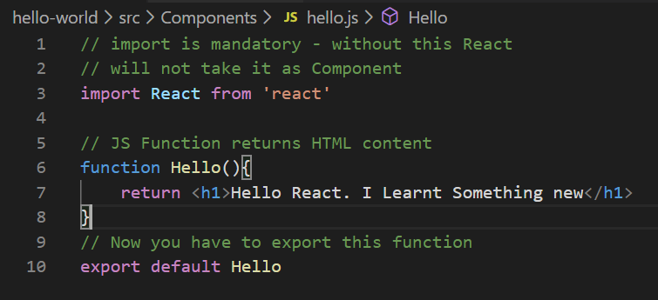
Your First Component
Lets create new folder “Components” under src
Create a new JS file – Hello.js
Create JS function
Your Component is created

Slide 14
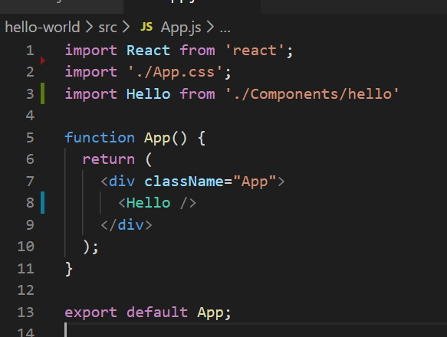
Add this Component in Main App:
Go to App.js
Import your new Component
Modify App() function – call new component as HTML tag.
Check the Browser

Slide 15
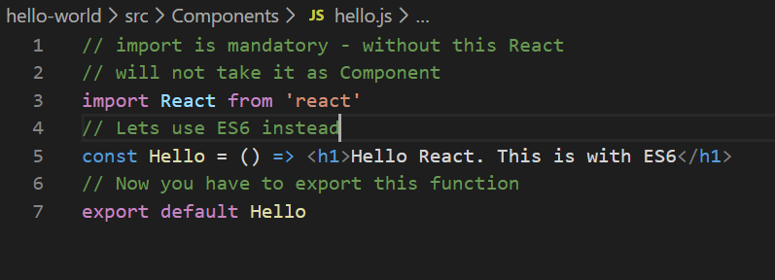
Use ES6 Arrow Function
const Hello = () => <h1> Hello React </h1>

Slide 16
Exporting as Named Constant
Remove default export:
export const Hello = () => <h1>Hello React. This is with ES6</h1>
In App.js : import {Hello} from './Components/hello'

Slide 17
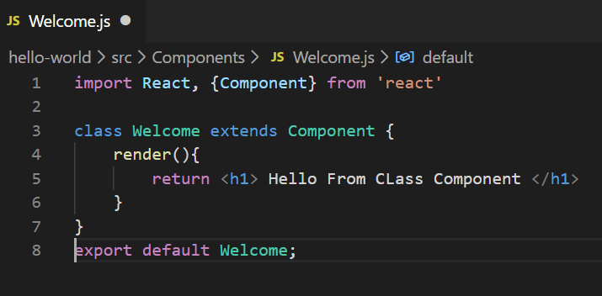
Class Components
ES6 Classes
Extends Components
Maintain Private states

Slide 18
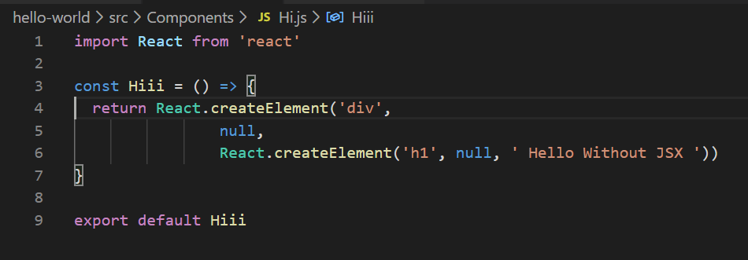
JSX
JavaScript XML – XML Like Code (Very similar to HTML)
Tag Name, Child and Attributes
Makes code simpler and elegant
Lets understand how JSX brings simplicity in code. Lets create one simple component without JSX
Note: Use second parameter to pass attributes:
{id: "div121" , className: "dummyClass"},

Slide 19
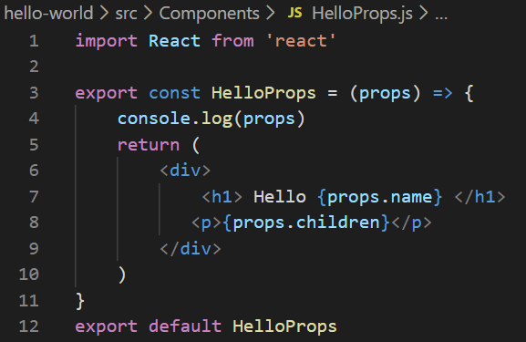
Props
Props are properties we can pass to Components.
Props are Key:Value Pairs
You can access Props with {props.key}
Props are immutable and final

Slide 20
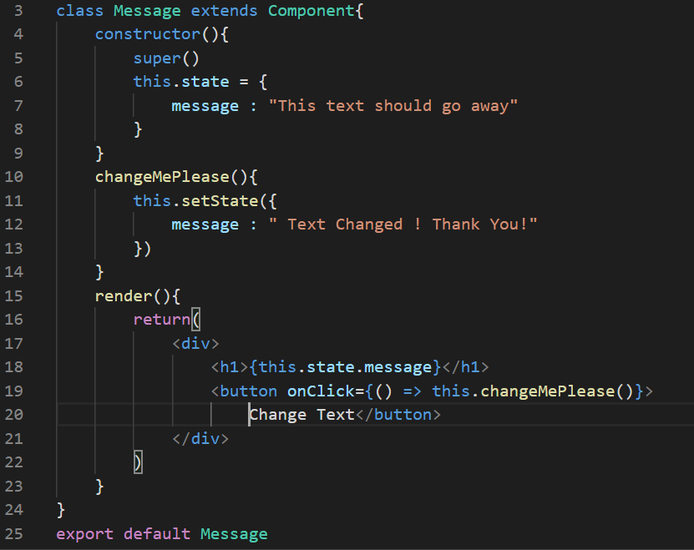
State
Managed within Component
Variables declared in function body
State can be changed
useState Hook
Mark the use of Constructor and Functions in ES6
Assignment: Create Click Counter. Have a Counter on Screen with a button. When button gets clicked counter should be increase.

Slide 21
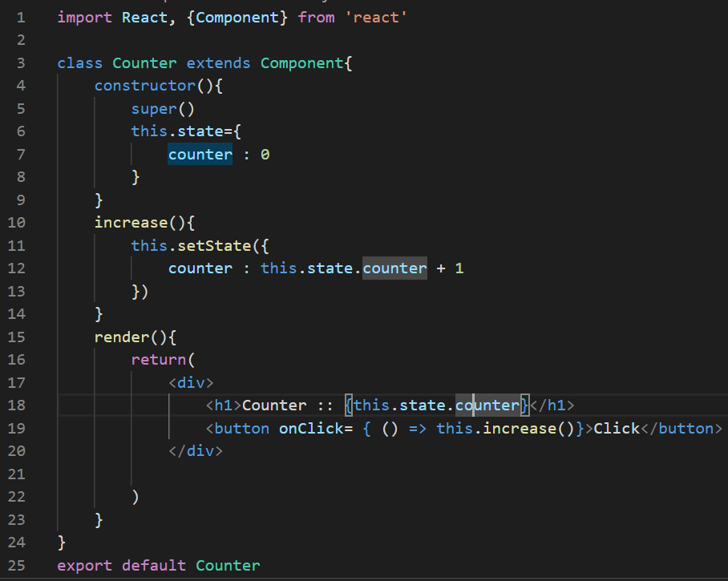
Assignment:

Slide 22
Parent & Child Components
Can One Component have child component?
Lets see an example

Slide 23
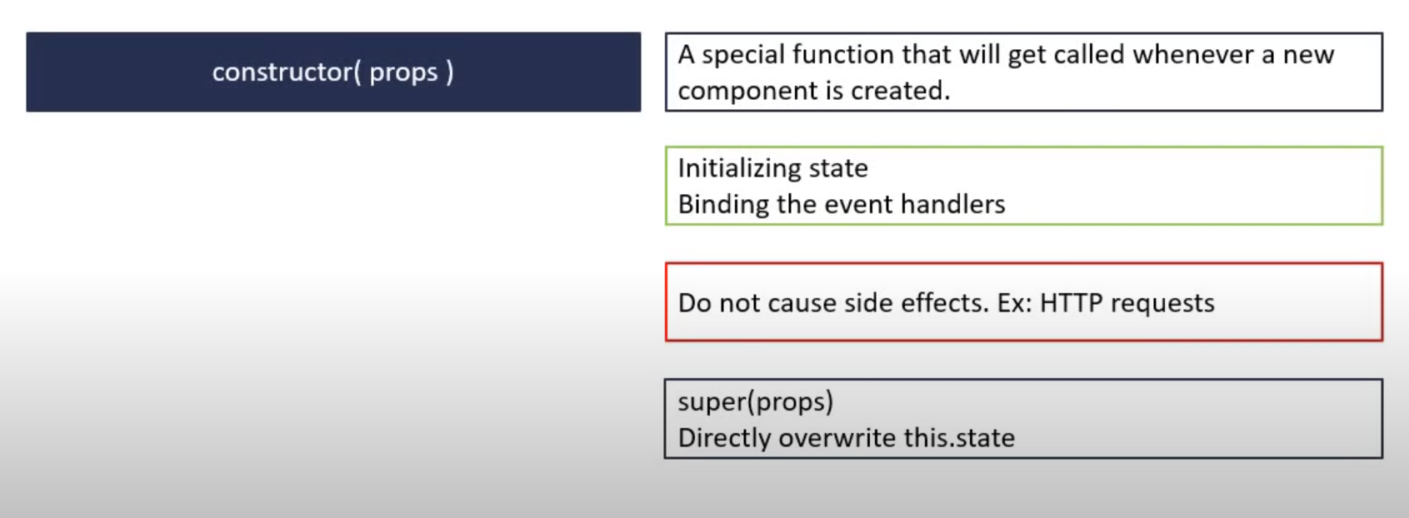
Component Life Cycle Methods

Slide 24
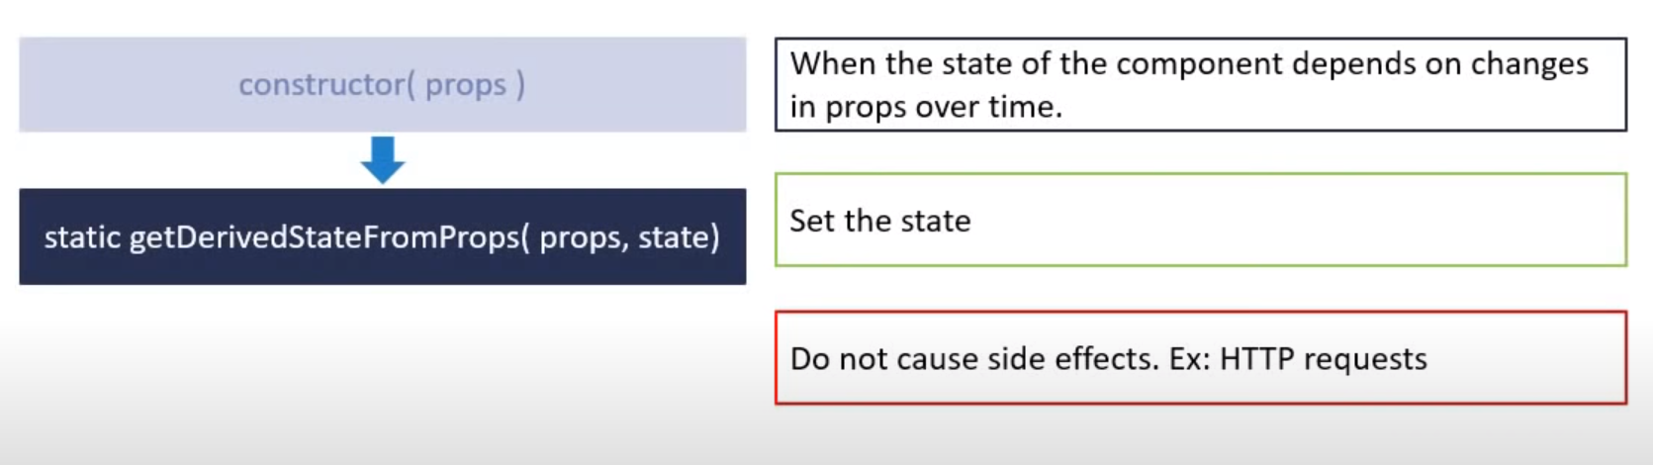
Component Life Cycle Methods

Slide 25
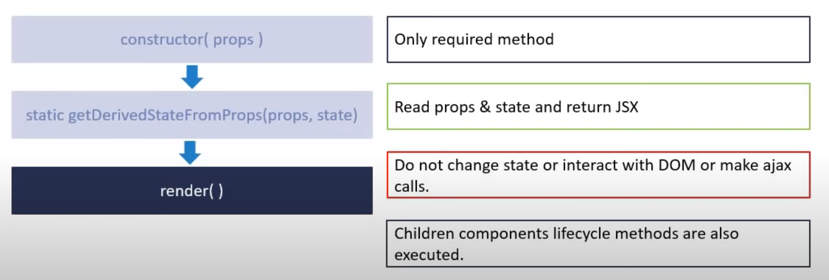
Component Life Cycle Methods

Slide 26
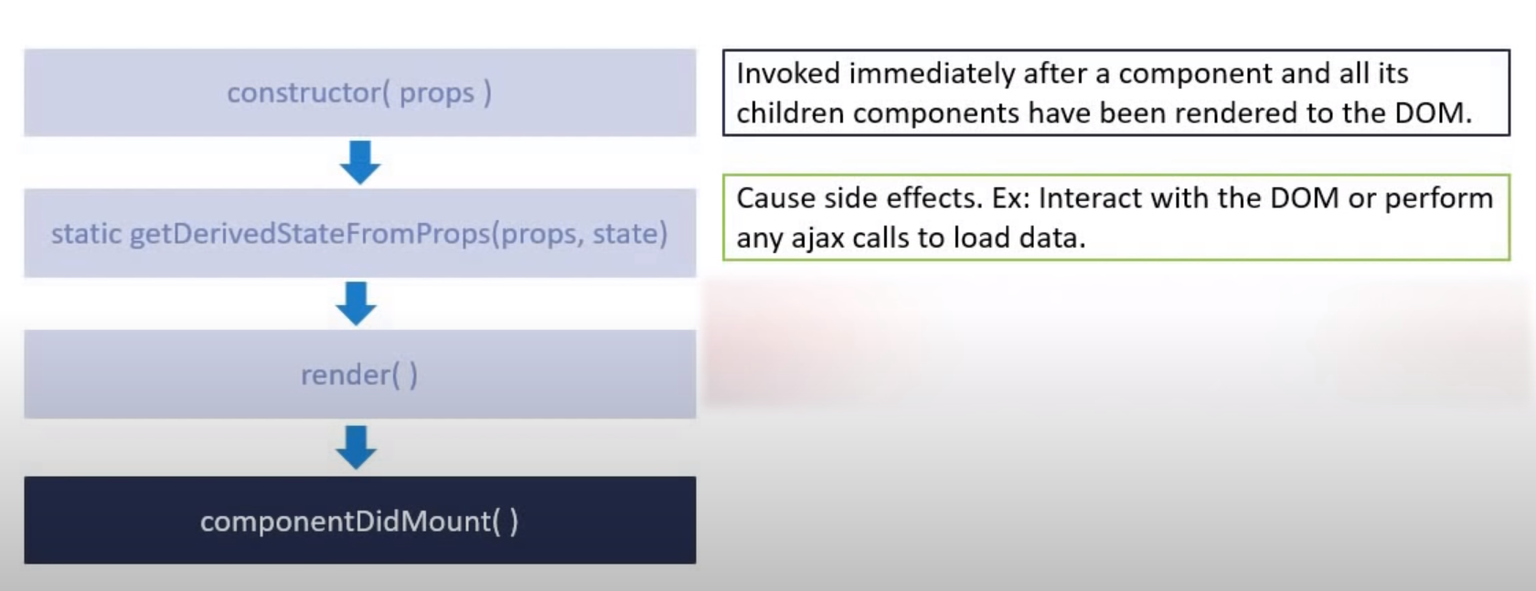
Component Life Cycle Methods

Slide 27
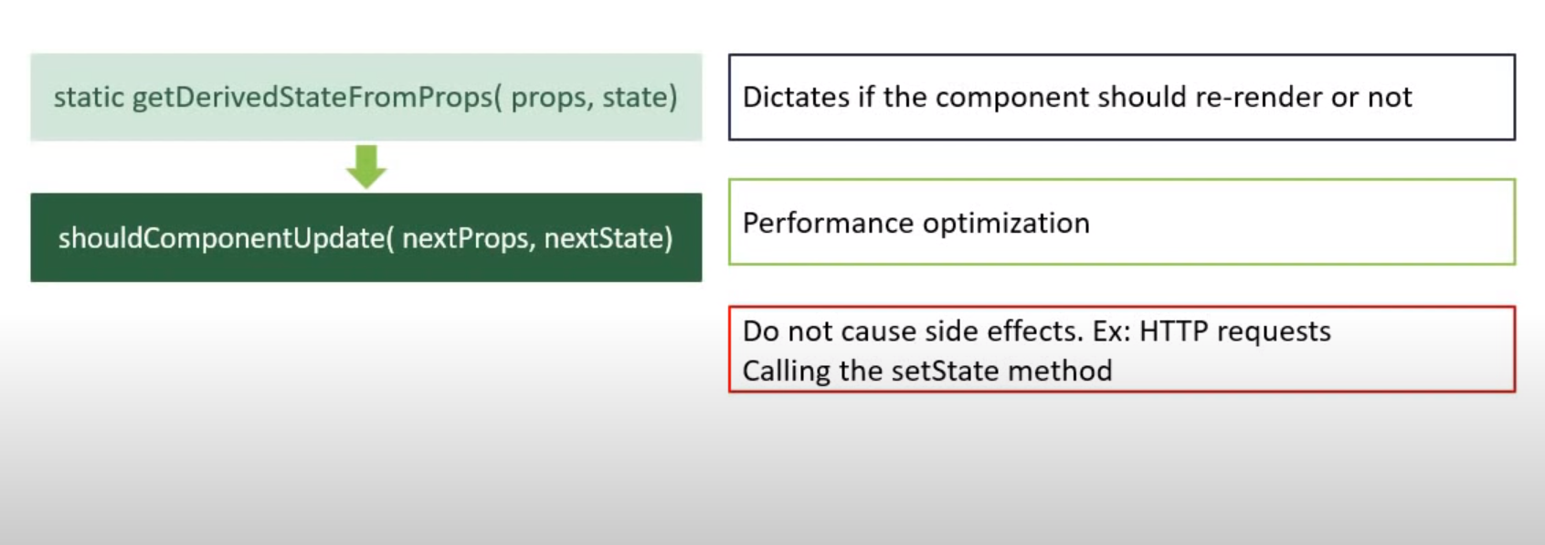
Component Life Cycle Methods

Slide 28
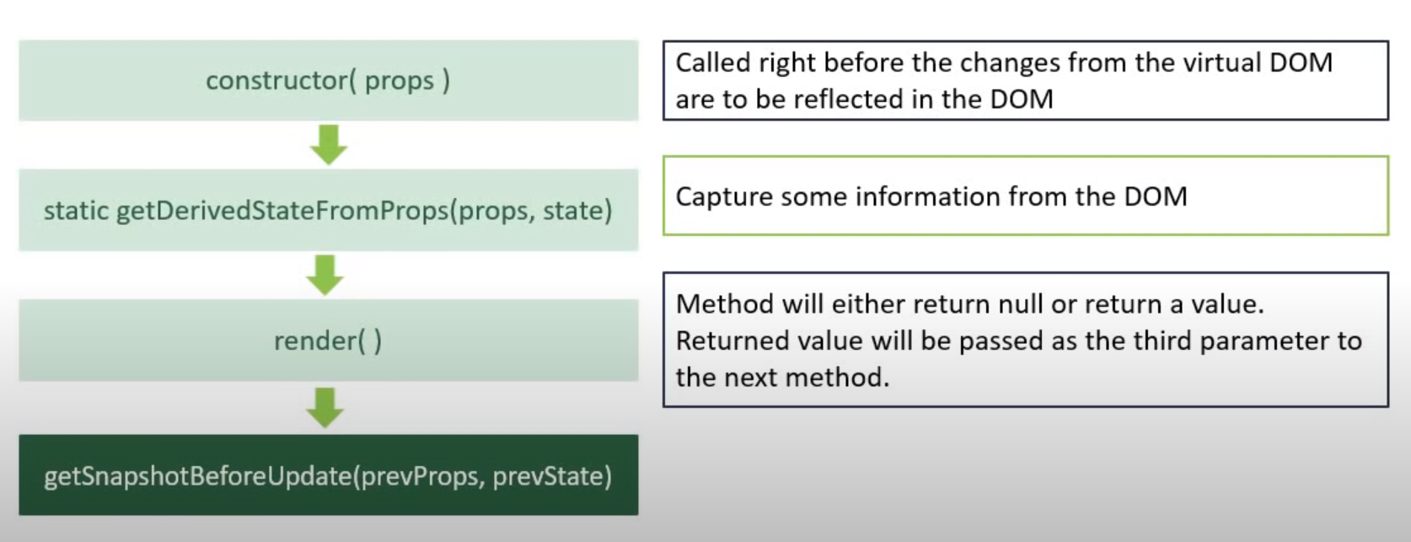
Component Life Cycle Methods

Slide 29
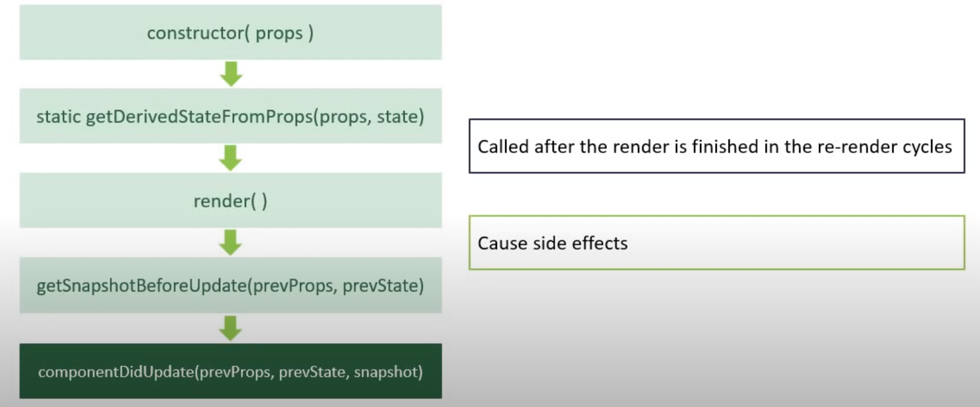
Component Life Cycle Methods

Slide 30
PureComponent
React.PureComponent is similar to React.Component. The difference between them is that React.Component doesn’t implement shouldComponentUpdate(), but React.PureComponent implements it with a shallow prop and state comparison.
https://reactjs.org/docs/react-api.html#reactcomponent

Slide 31
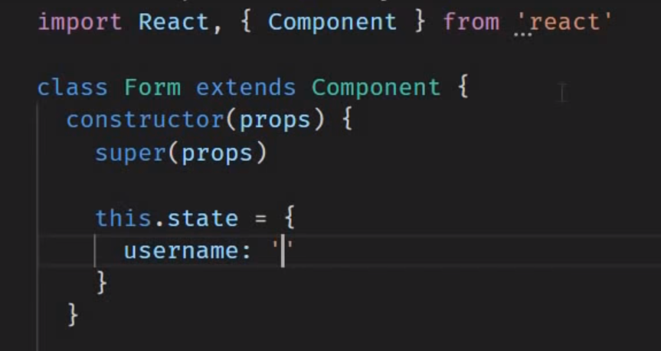
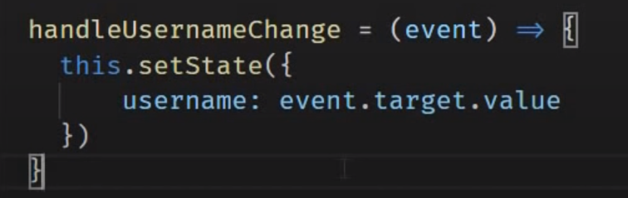
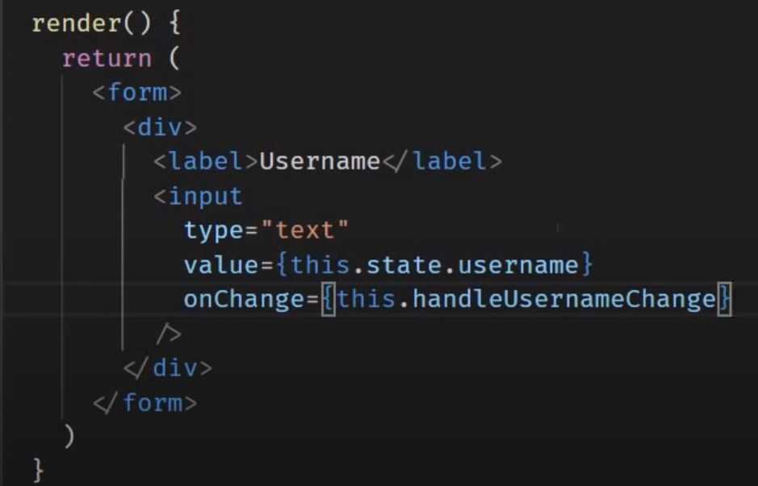
Handling Forms Fields

Slide 32
Calling Http Get Method
npm install axios
Get the sample REST Calls: https://jsonplaceholder.typicode.com/

Slide 33
Context
Context provides a way to pass data through the component tree without having to pass props down manually at every level.
Context is designed to share data that can be considered “global” for a tree of React components, such as the current authenticated user, theme, or preferred language.

Slide 34
Context
App
userName
userName
userName
A
B
C
userName
D
E
F

Slide 35
Context Use:
Create the Context
Provide the Context Value in App.js
Consume the Context value in required js

